Slide 1
Network Analysis
By Ankita Ray

Slide 2
Introduction
Network techniques are the pictorial representation of various tasks, their interdependencies, and activities that must be completed to complete the entire project.
They also speak about the interrelationship between the various tasks or activities, which helps in planning, scheduling, monitoring, and controlling the project.
In the case of small projects, perhaps, the requirement of sophisticated techniques is not all that important. Still, as the project gets more complex, the allocation of scarce resources becomes difficult, without any scientific aid or technique. At these times, the project manager is helped by network design and related review techniques.

Slide 3
Topics in Network Analysis
The various topics in network analysis can be grouped into four broad areas as follows:
Critical Path Method (CPM)/Float Analysis:
In this case, the network is based on activities, using the activity on arrow (AOA) convention. It was first developed by DuPont in USA for their Nylon 6 project and is used in situations where the activity times are known deterministically. The first step is the construction of the network diagram and the subsequent steps include the following: to identify the early start (ES), earliest finish (EF), latest start (LS), and latest finish (LF). With the help of this information, we can identify the surpluses on activities, termed as ‘floats’, and the components of floats such as total float, interfering float, free float, and independent floats.

Slide 4
Cont..
2. Program Evaluation and Review Technique (PERT):
For many probabilistic projects such as projects in research and development or space projects, it is not possible to predict the exact time for the activities. In such situations, instead of the activities that track the progress of a project against time, milestones are established for monitoring their progress against time. These milestones are termed as ‘events’. Thus, the PERT network is event-based. This technique was first developed by the US Navy for its Polaris missile project. Such situations where activity times cannot be predicted with confidence are called stochastic or probabilistic situations. Here, we use three estimates of activity durations namely, the optimistic time (To ), most likely time (Tm ), and the pessimistic time (Tp ). In the case of PERT networks, the average time for completion of an activity is calculated and the sum total of the average times for all the activities on the critical path is the average time for completion of the project. As ‘average’ times are involved for project duration, we also consider the standard deviation for the project completion times,which would help us arrive at confidence intervals for project completion based on available time.

Slide 5
Cont..
3. Crashing of a Project:
For every project, the cost component may comprise two components—direct cost and indirect cost. Although the direct cost occurs irrespective of the time taken to complete the project, the indirect cost is a function of the project duration and thus can be targeted for reduction by reducing the project duration. Completing the project in less time than earlier planned is termed ‘crashing’. Crashing is carried out for the twin benefits of reducing indirect costs and thus, the total cost, besides the advantages of reduced time duration for completing the project. There may be some increase in direct cost as a result of crashing due to the required additional efforts and resources, but the substantial advantages offset this increase. The second benefit is that the project gets completed before the scheduled time and it is often advantageous to do so as in most cases, additional rewards/monetary benefits are available for completing the project early. However, infinite crashing is not possible and is limited by either the technical limitations, if any, of minimum time for completing an activity, or the cost considerations.

Slide 6
Cont..
4. Network Using the Activity on Node (AON) Convention or Precedence Diagramming Method (PDM):
In this case, the activity is shown at the node and is joined by arrows depending upon their logical relationship. Much information can be shown in the network using the AON convention, unlike in the case of activity on arrow (AOA) network. Second, in most practical situations, succeeding activities can proceed simultaneously with the preceding activity with or without some time delay. This is because the entire predecessor activity doesn't need to be fully complete before the successor activity can start. Such parallel progress of activities is not possible under AOA convention, where the preceding activity must be fully completed before the succeeding activity can start. Most software programs use the PDM method for solving project network problems.

Slide 7
Network diagram and analysis using the activity ON arrow (AOA) convention
While constructing the network diagram using the AOA convention (or the AON convention), the only criteria is the predecessor or successor relationship.
The network diagram is the first stage of any network analysis, and hence, adequate attention should be paid to the details while constructing the diagram.

Slide 8
Application in a software company
The critical path method (CPM) is a project management technique that can be used to plan and schedule software projects. Here are some steps for using CPM:
Identify tasks: Identify all tasks required to complete the project
Determine sequence: Determine the order in which the tasks will be completed
Estimate durations: Estimate how long each task will take
Draw a network diagram: Create a visual representation of the task sequences using a network diagram
Identify the critical path: Identify the longest sequence of tasks that must be completed on time
Calculate float: Calculate the float for each activity in the second longest sequence of activities
Monitor the critical path: Monitor the critical path to ensure the project stays on schedule
The CPM is also known as critical path analysis (CPA). It's a valuable tool for managing and communicating complex projects.

Slide 9
Constructing a Network Diagram
The various tools and techniques of project management are grouped into two heads, namely bar charts, milestone charts and velocity diagrams and network techniques.
Bar charts or Gantt charts are two-dimensional, pictorial representations of a project, with activities of the project shown on one axis and their durations represented on the other axis. Milestone charts are the modified and improved versions of bar charts with a primary difference that a mile stone chart is event-based whereas, a bar chart is an activity-based chart. Milestones such as bar charts cannot show the interrelationships between activities or events and give equal weightage to all activities, instead of more weightage to the critical path activities. Thus, they possess most of the drawbacks inherent in a bar chart. Velocity diagrams are useful for representing the activities which require groups of people working in a predetermined sequence.

Slide 10
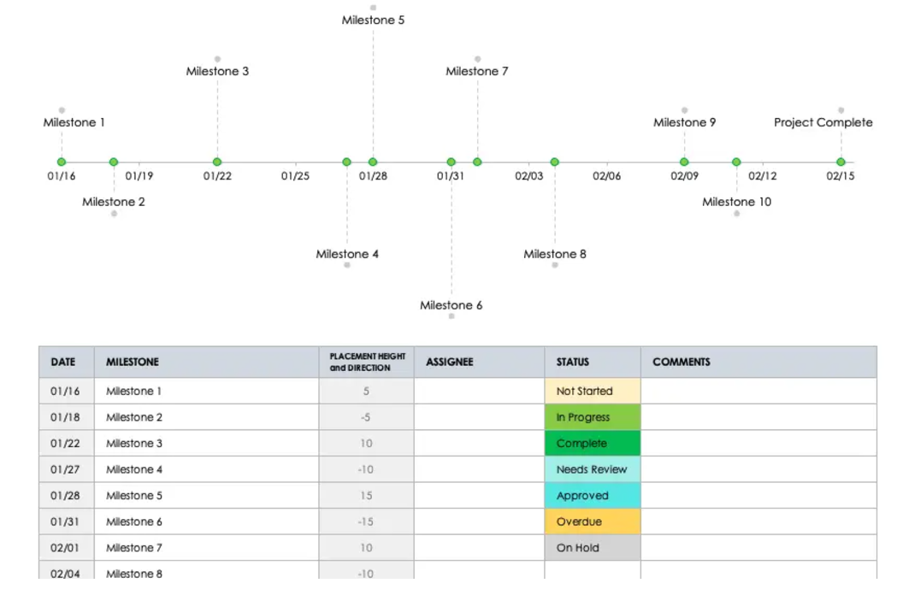
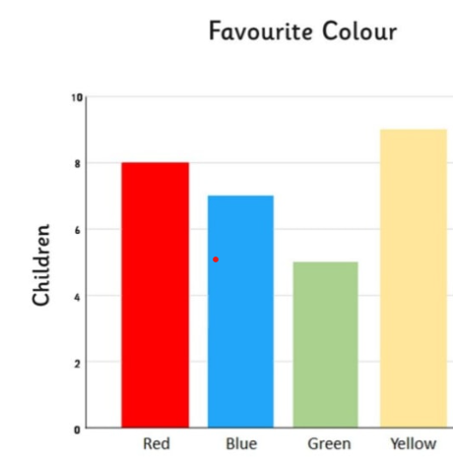
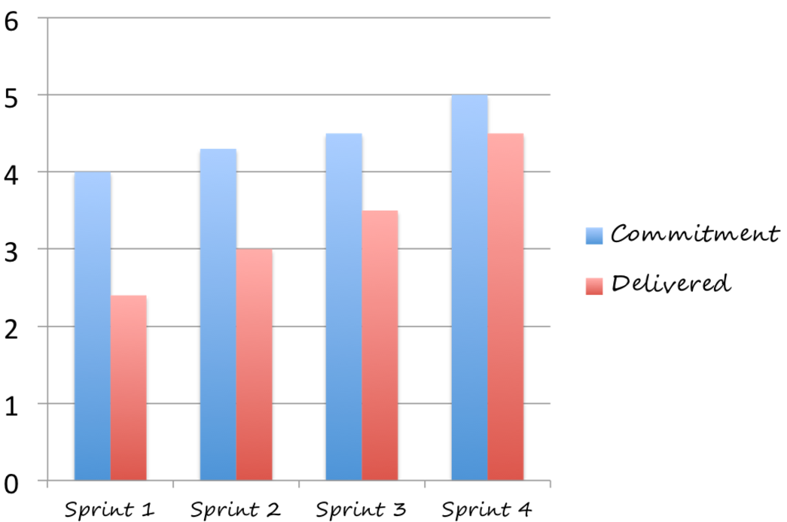
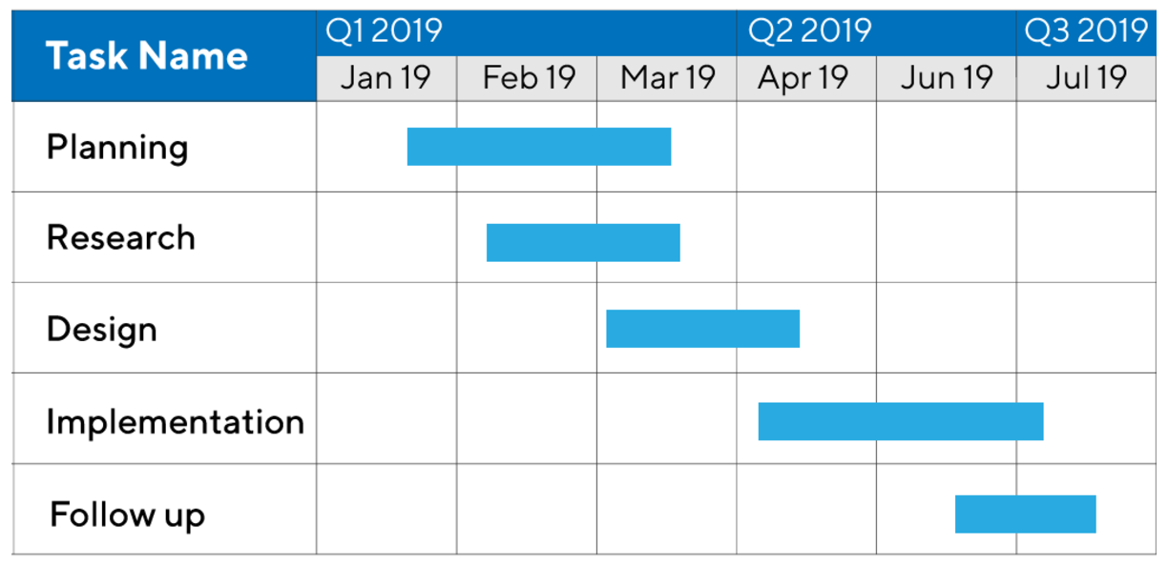
Bar Chart
Milestone chart
Gantt Chart
Velocity Chart

Slide 11
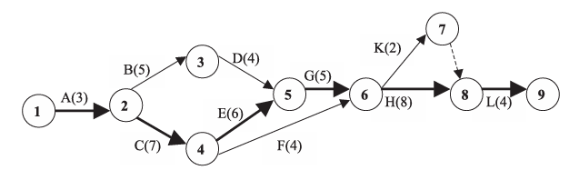
Cont..
A network comprises a series of activities linked to each other with a single start and a single end. Figure 1 shows a typical network diagram. The start for all the activities is the event or node 1 and the finish for all the activities is the end node 9.
The activity names are written above the arrows depicting the activities. It may be noted that each activity has a start node also known as tail event or node and a finish node also known as a head event or node.

Slide 12
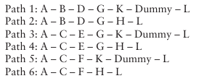
Important for network diagram
Furthermore, no two or more activities can have the same start and the same end.
While two or more activities can have a same start or a same end, none may have the same start and the same end.
One of these paths is the path of maximum duration and is therefore, called the critical path (Path 3 is the critical path in this case and is shown in bold lines in the network). On this path, no delays can be admissible but on the other non-critical paths, some delays can be permitted.

Slide 13

Cont..
In general, while constructing a network, we must keep the following points in mind:
Every activity must have a start and an end. The direction of activity progression should be clearly mentioned. On such example is as shown in Figure 2. The figure adjoining the activity is the duration of the activity. Event or node 1 is the start node and event or node 2 is the end node.

Slide 14
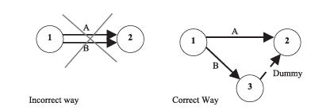
Cont..
2. In case two (or more) activities have a common start and a common end, then this relation has to be shown with a dummy activity. A dummy activity does not consume any resources but is used to show relationships. This is shown below.

Slide 15
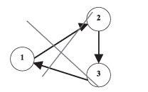
Cont..
3. While constructing the network only the predecessor relationships are considered and not the duration. This means that the length of an activity in the network is not proportional to its duration.
4. There should not be any loops in the project network. The relationship of the loop which is not allowed is shown below..

Slide 16
Cont..
5. The numbering pattern for events should be such that the head event should have a higher number than the tail event. In some cases, this may not hold true and it is fine. However, as far as possible, this rule, known as Fulkerson’s rule devised by D.R. Fulkerson, should be followed. In general, the numbering pattern is ascending order from left to right and top to bottom.

Slide 17
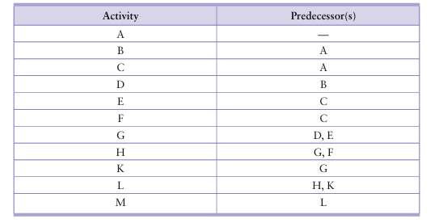
Exercise 1
Table 1 . Activities with predecessor relationships
Construct the network for the following predecessor relationship shown in Table 1

Slide 18

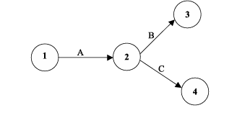
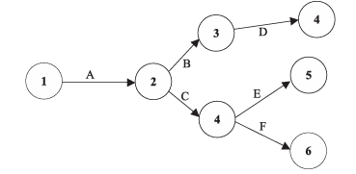
1. Activity A has no predecessor, and hence, we start with activity A. We are at liberty to name the events in any which way and at times, a situation of some activity going from event 3 to event 2 is also fine. The numbering pattern is ascending order from left to right and from top to bottom.
2. After activity A is complete, two activities namely, B and C can commence simultaneously.
3. Activity D can start after activity B and activities E and F can start after activity C is completed.

Slide 19
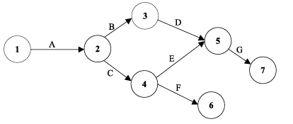
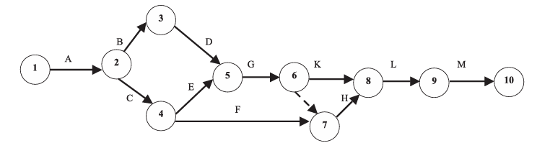
4. Activity G depends on the completion of both D and E. Now, D is completed in node 4 and E is completed in node 5. However, we need a common point where both D and E have ended, and hence, we make the changes to the network as follows:
5. Activity H depends on G and F, which means for H to start, there has to be a common point where both G and F end. However, activity K depends only on the completion of activity G, and hence, there has to be an event where only G is complete and an event where both G and F are completed. This is shown by a dummy activity.

Slide 20
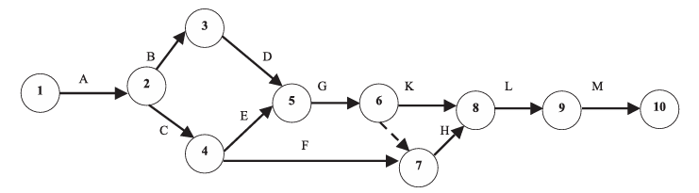
6. Activity L depends on the completion of two activities H and K, and hence, we have to end both activities H and K in one node and show L originating from the common end point. The last activity is activity M, which depends on activity L.

Slide 21
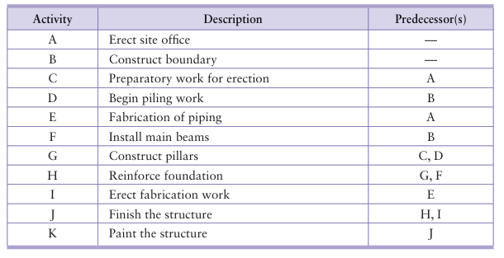
Q. 1. Draw a network for the project of erection of a steel warehouse. The various activities involved in erection of the steel warehouse along with the predecessor relations are outlined below in Table 2
Table 2 . Activities with predecessor relationships

Slide 22
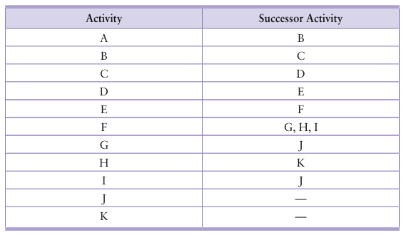
Q.2. The activities of the project, along with their inter-relationships are given in Table 3. Construct a network for the same.
Table 3 . Activities with successor relationships

Slide 23
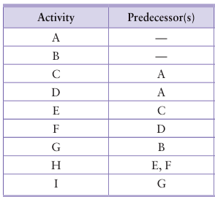
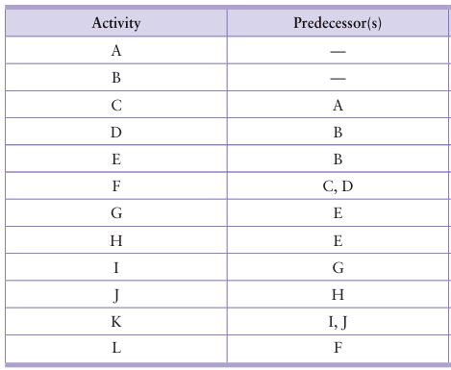
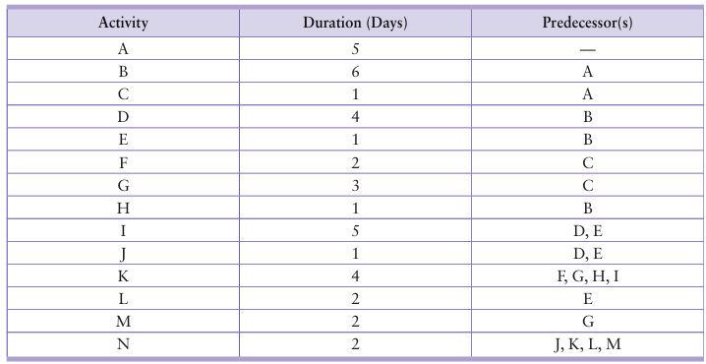
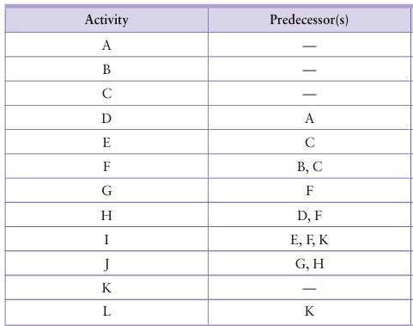
Assignment 1a: Draw the network of the following projects
Total= 10marks
[Assignment 1= Assignment 1a+ Assignment 1b + Assignment 1c]

